Slide 1




EXCELSSIOR EDUCATION SOCIETY’S K. C. COLLEGE OF ENGINEERING AND MANAGEMENT STUDIES AND RESEARCH (Affiliated to the University of Mumbai) Mith Bunder Road, Near Hume Pipe, Kopari, Thane(E)-400603
Department of Computer Engineering
Academic Year 2023-24(Odd Semester)

Slide 2
Index
Introduction to Topic
Need of Project
Problem Statement
Literature survey In Tabular Format
Algorithm for Project Development
Block Diagram
Flow-chart
Requirement Hardware and Software
Feasibility Study
Proposed Methodology
Detail Design DFD Diagram
Activity Diagram
Screenshots of GUI
References

Slide 3
Introduction to Topic
In the dynamic landscape of modern organizations, the effective management of human resources is paramount to achieving strategic goals and maintaining a competitive edge. The HR Management System (HRMS) emerges as a comprehensive solution, seamlessly integrating technology and human resource management practices to streamline processes, enhance efficiency, and foster a more strategic approach to workforce management.
The HRMS serves as the central hub for all HR-related activities within an organization, providing a robust platform for managing employee information, recruitment, performance appraisal, training, and more. This system not only automates routine HR tasks but also empowers HR professionals with valuable insights through analytics, aiding in informed decision-making.
In this digital age, HR MANAGEMENT SYSTEM With the advent of technology The HRMS consolidates and centralizes employee data, providing a secure and accessible repository for personal details, qualifications, and performance records.
Facilitating employee development, the HRMS aids in planning, implementing, and tracking training programs to enhance skills and knowledge.
As organizations continue to recognize the strategic importance of their human capital, the HRMS emerges as a critical tool in fostering a positive employee experience, ensuring compliance with regulations, and driving organizational success. This introduction sets the stage for exploring the various dimensions and functionalities of the HR Management System, ultimately contributing to the evolution of modern HR practices within the organization..

Slide 4
Need of Project
The need for a Human Resources (HR) Management System stems from the growing complexity of modern organizations and the crucial role HR plays in managing human capital effectively. Here are some key points highlighting the necessity of such a system:
A Human Resources (HR) Management System serves as a centralized hub for employee information, automating administrative tasks and enabling data-driven decision-making. By ensuring compliance with evolving regulations and streamlining processes like payroll and leave management, it empowers HR professionals to focus on strategic initiatives. Through intuitive self-service portals and enhanced communication channels, it fosters employee engagement and collaboration while adapting to organizational growth and complexity. In essence, it's a vital tool for modern businesses to optimize HR operations, promote transparency, and drive sustainable success through effective talent management
Centralized Data Management: A HR Management System provides a centralized platform to store and manage employee information such as personal details, job history, performance evaluations, training records, and benefits. This centralized database ensures data integrity, security, and accessibility.
Streamlined Processes: Traditional paper-based HR processes can be time-consuming, error-prone, and inefficient. An HR Management System automates routine administrative tasks such as payroll processing, leave management, and employee onboarding, thereby freeing up HR personnel to focus on strategic initiatives.

Slide 5
Problem Statement
Inefficient and disjointed human resources (HR) management processes within our organization hinder productivity, compliance, and employee engagement. Manual handling of tasks such as employee data management, payroll processing, leave tracking, and performance evaluations results in errors, delays, and suboptimal decision-making. Lack of a centralized HR management system leads to data fragmentation, compliance risks, and difficulty in accessing real-time insights for strategic workforce planning. Moreover, the absence of streamlined communication channels and self-service options undermines employee satisfaction and engagement levels. To address these challenges and enhance organizational efficiency, there is a critical need for the implementation of a comprehensive HR management system that integrates seamlessly with existing workflows, ensures regulatory compliance, empowers employees, and enables data-driven decision-making processes.

Slide 6
Literature survey In Tabular Format
Year | Associated Person/People | State of the System
1982 | Walker A.J. | HRIS development: Project team guide to build effective personnel information system
1984 | Beer et al | Defined HRM as those involved in complex decision.
1999 | Robert b. | Calculating return on investment on HR
2005 | Hufelid, M.A | Becker work force of cord card management Human capital to execute strategy
2006 | Behuselid | Strategic HR management, from journal of management
Notes:
2006 Behuselid Strategic HR management, where do we go from here, from journal of management 2005 Hufelid, m.a, Becker Work force of core card management Human capital to execute strategy
1999 Robert b. Calculating return on investment on HR.
1982 Walker A.J. HRIS development: A project team guide to building an effective personnel information system.

Slide 7
Algorithm for Project Development
1.Project Initiation: a. Define project Objectives: Create a HR Management System which helps to maintain records of employee and improve communication.
b. Provide performance reviews as well as track record of hours attended by employee
c. Access resources and timeline feasibility
2. Planning and Design :
a. Design the UI architecture for Admin, HR, Manager and Employee
b. Create a database to maintain all the records and information
c. Make a connection between all the different profiles
3. Development:
a. Build different profiles and features regarding each profile
b. Code in order for these profiles to interact.
c. Implement for each profile to send, receive or update data accordingly
4. Testing:
a. Test the app for functionality, user-friendliness and performance
b. Address and fix any identified issues

Slide 8
Algorithm for Project Development
5. User Testing: a. Conduct beta testing with a small group to gather user feedback. b. Make improvements based on user suggestions.
6. Development: a. Develop the program in order for it to receive, store or update data.
7. Documentation:
a. Documentation app architecture, design decisions and key features. b. Create instructions for user to easily operate.
8. Project Closure:
a. Verify project completion and compliance with standards. b. Archive project data and records.
9. Post- Project Review:
a. Evaluate project performance against objectives.
b. Identify areas for improvement and lessons learned.

Slide 9
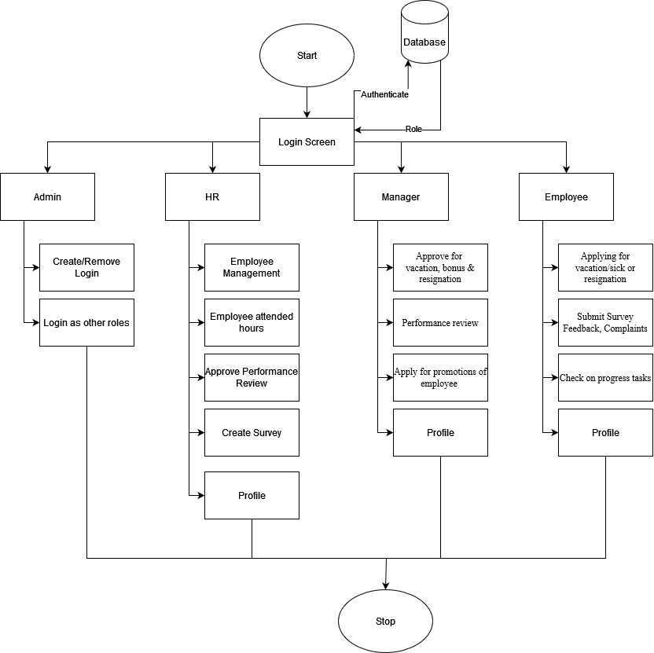
Block Diagram

Slide 10
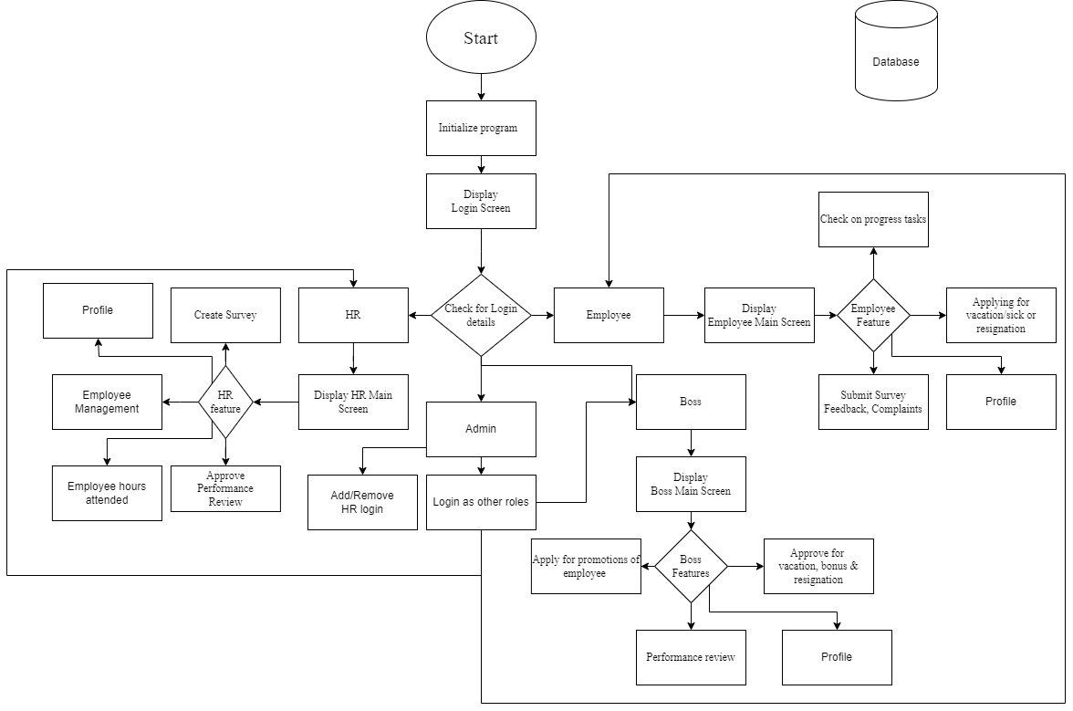
Flow-chart

Slide 11
Requirement Hardware and Software
Hardware :-
Minimum Requirements:
Processor:- Dual core processor @2.4Ghz
Ram:- 4GB Ram
Storage:- 2GB free space
Recommended Requirements:
Processor:- Quad core processor @2.8Ghz
Ram:- 8GB Ram
Storage:- 4GB free space
Software Need as follows: - 1. All Modules of Python should be installed 2. Path of python should be specified 3. OS 10 is required 4. Internet access required
Notes:
Need as follows: 1. All Modules of Python should be installed 2. Path of python should be specified 3. OS 10 is required 4. Internet access required

Slide 12
Feasibility Study
Technical Feasibility:
Python latest module required.
Internet access required.
2. Economic Feasibility:
Development costs are manageable within the allocated budget.
Firebase is cost efficient database to use.
3. Operational Feasibility:
The project aligns with the organization's capabilities and resources.
Integration into existing operations is feasible.
4. Legal and Regulatory Feasibility:
No significant legal barriers are foreseen, and compliance.
5. Scheduling and Time Feasibility:
Project timelines allow for timely development and deployment.
Notes:
a. Python latest module required b. Internet access required

Slide 13
Proposed Methodology
1. User Interface: -
a. Intuitive design for employee self-service and admin dashboards.
b. Responsive and user-friendly interface.
2. Database Management: -
a. Centralized database for secure storage of employee data.
b. Database management system for efficient data retrieval.
3. Application Logic: -
a. Employee Onboarding: Digital forms and document submission.
b. Attendance Tracking & Performance Records
c. Performance Management: Goal setting, feedback mechanisms.
d. Employee Self-Service: Leave requests and personal information.
4. Technologies Used: -
a. Frontend: Python
b. Backend: Python
c. Database: Firebase

Slide 14
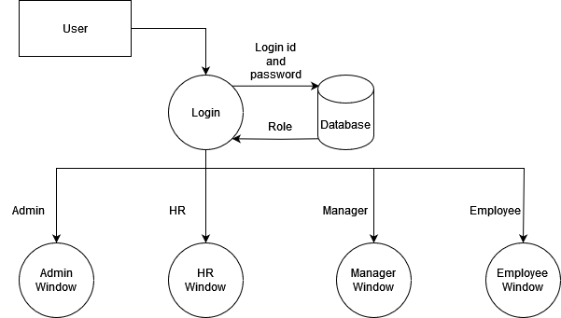
Data Flow Diagram Level 0

Slide 15
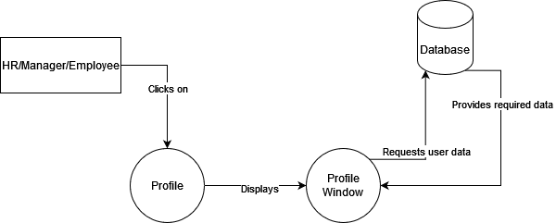
Data Flow Diagram Level 1

Slide 16
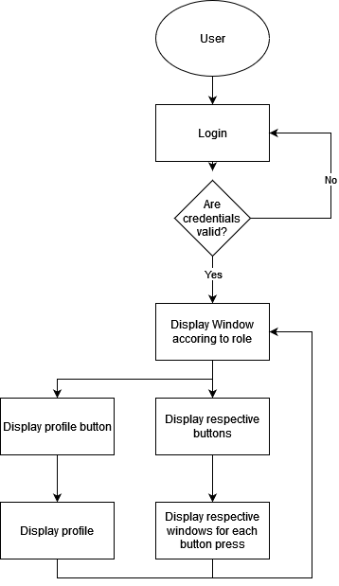
Activity Diagram

Slide 17
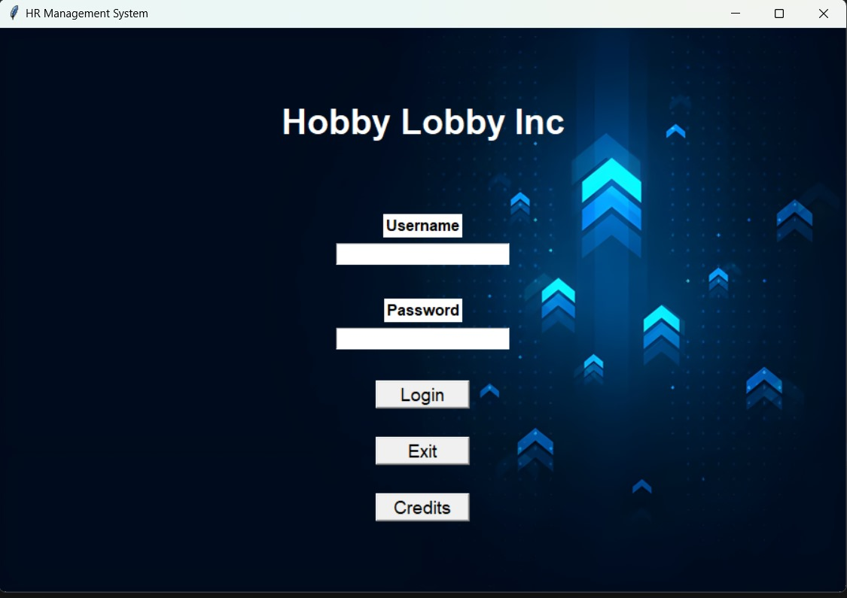
Implementation Details/ Screenshots of GUI
Main Login:
Shows the you can login as HR, boss, employee and admin in the project by giving the correct id and password and perform the given task.
Figure 1

Slide 18
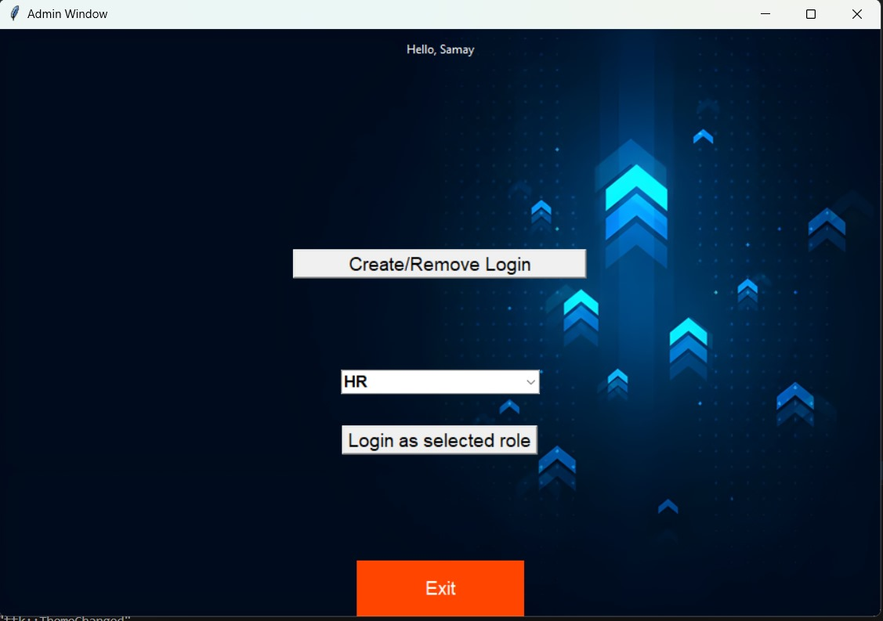
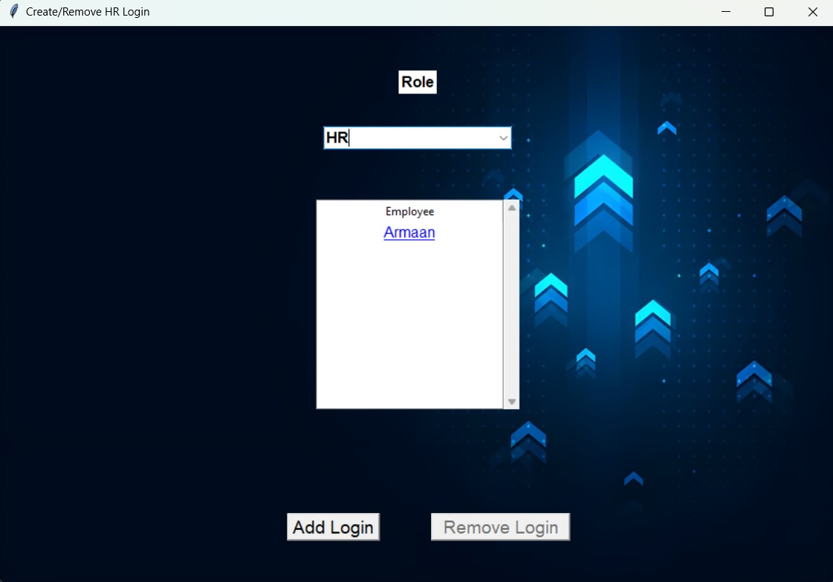
Game Options Screen:
The role of an administrator (admin) in a Human Resources Management System (HRMS) is crucial for ensuring the effective and efficient operation of the system. Administrators typically have elevated permissions and responsibilities within the HRMS platform. Here's an overview of the role of an admin in an HRMS:
1) System Configuration and Setup: This includes defining user roles and permissions, configuring workflows, customizing forms and templates, and setting up integrations with other systems if necessary.
2) Training and Support: Admins provide training and support to users of the HRMS platform, including HR professionals, managers, and employees.
Login Admin: -
Figure 2
Figure 3

Slide 19
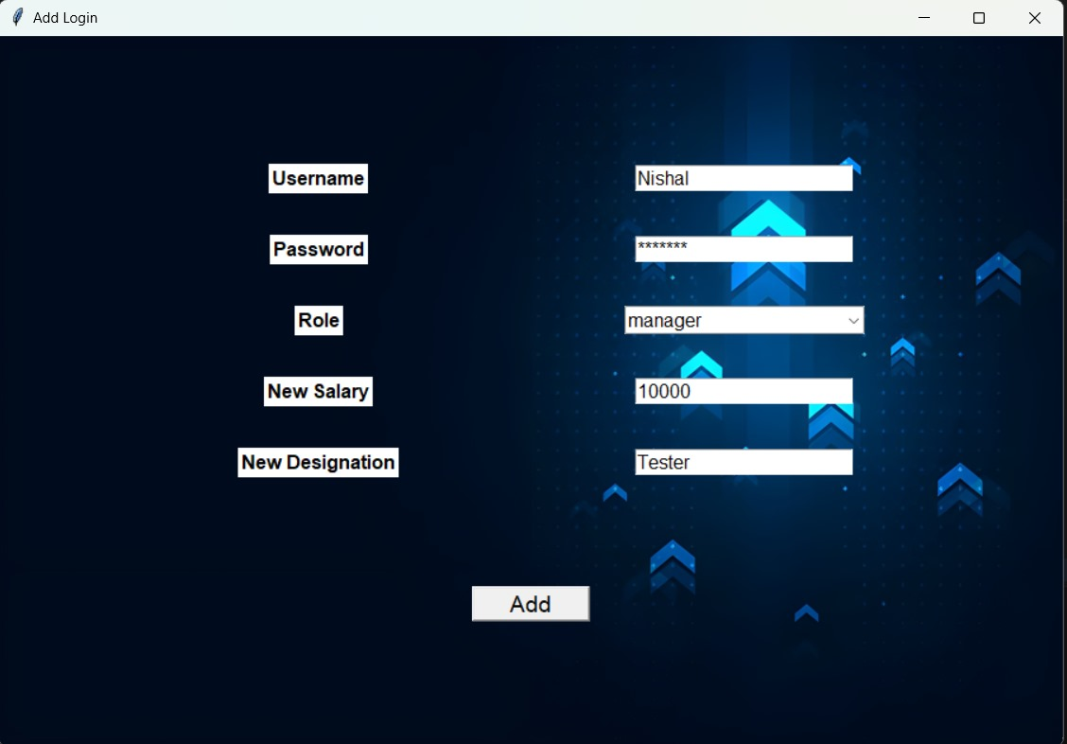
Login Admin: -
3)The admin can create or remove the role of hr. he can manage the salary of all staf .and the admin can login as employee ,boss and hr chek their progress
Overall, the role of an admin in an HRMS is multifaceted and requires a combination of technical expertise, administrative skills, and knowledge of HR processes and practices. Admins play a critical role in maximizing the value and effectiveness of the HRMS platform within the organization.
Figure 4

Slide 20
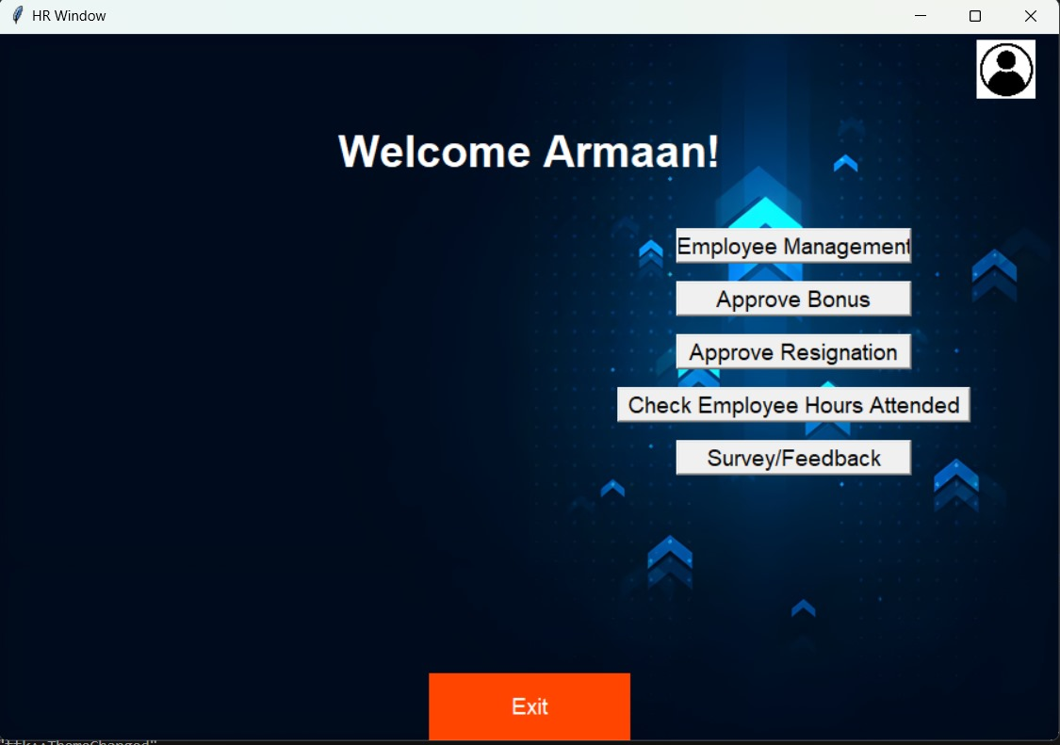
Game Options Screen:
Login HR: -
The role of HR (Human Resources) in a Human Resources Management System (HRMS) is central to the effective management of an organization's human capital and related processes. Here's an overview of the role of HR in an HRMS:
This is the main login page of hr . the hr can do the employee management ,Approve of the bonus of the employee ,and approval of the resignation
The hr can also check the how many hours can employee attended in the office and it can give the survey feedback
Figure 5

Slide 21
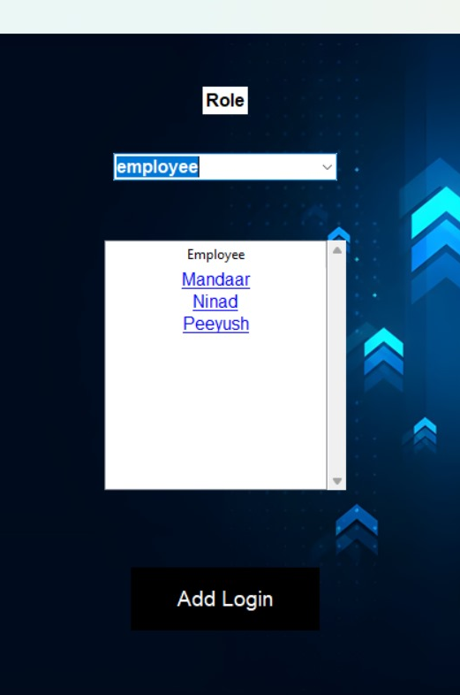
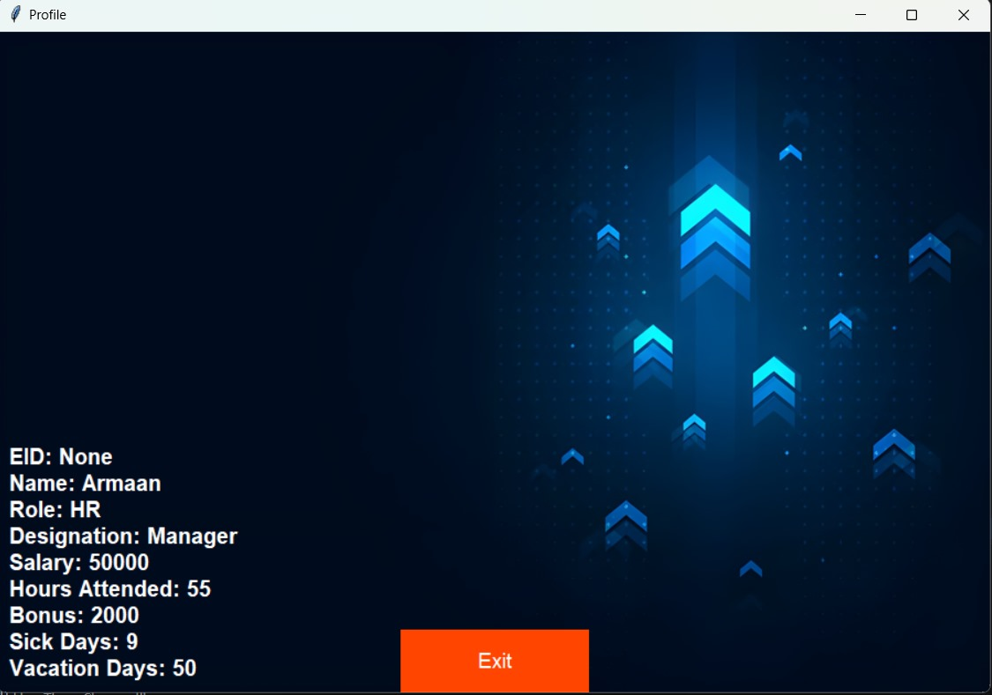
Login HR: -
The figure 6 :-
shows the profile picture of the hr it shows the all each and every details of hr management system.
The figure 7:-
It shows the hr can manage the salary of the employee
Overall, the role of HR in an HRMS is to leverage technology to streamline HR processes, improve data accuracy and accessibility, enhance employee experiences, and support organizational goals and objectives related to talent management and development. By effectively utilizing the HRMS, HR can become more strategic and proactive in managing the organization's most valuable asset—its people.
Figure 6
Figure 7

Slide 22
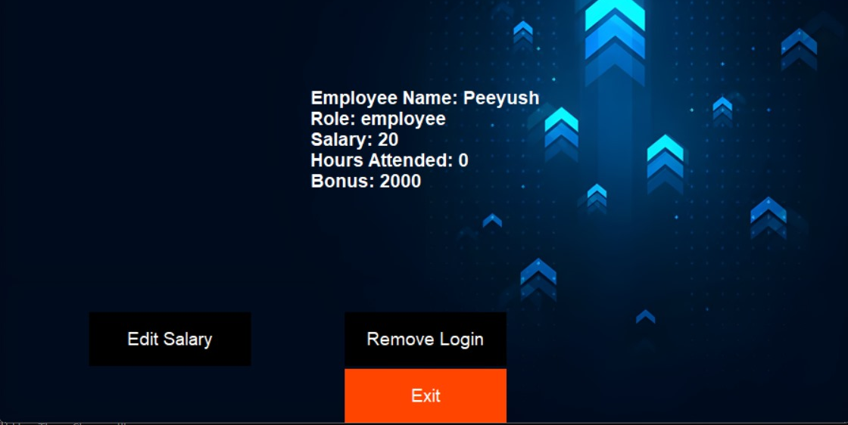
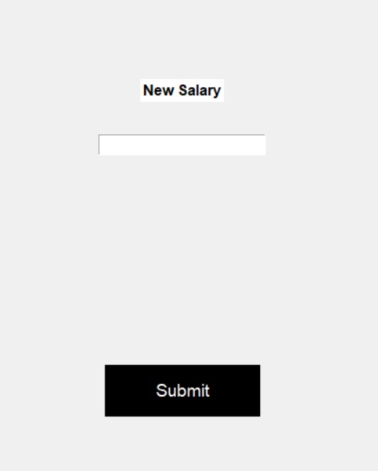
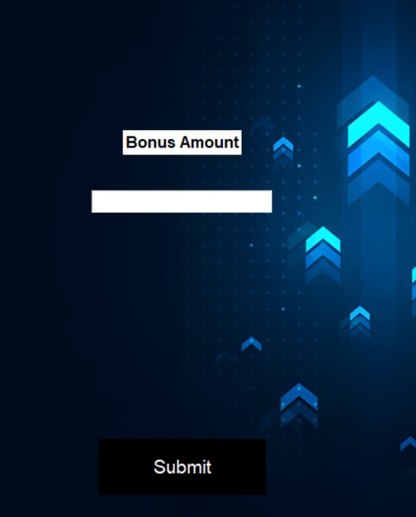
Login HR: -
In figure 8 it shows the details of the employee ,salary ,role ,attended and bonus .if they want to remove login they can remove also and they can edit salary also Figure 9:-
it show the if the hr wants to edit the salary of the if he wants to reduce or increase the salary of the employee
Figure 10:-
The figure 10 shows the grant bonus for manager. Granting bonuses for managers means giving them extra money based on how well they lead their teams, achieve goals, and contribute to the company's success. It's like a reward for doing a great job as a manager.
Figure 8
Figure 10
Figure 9

Slide 23
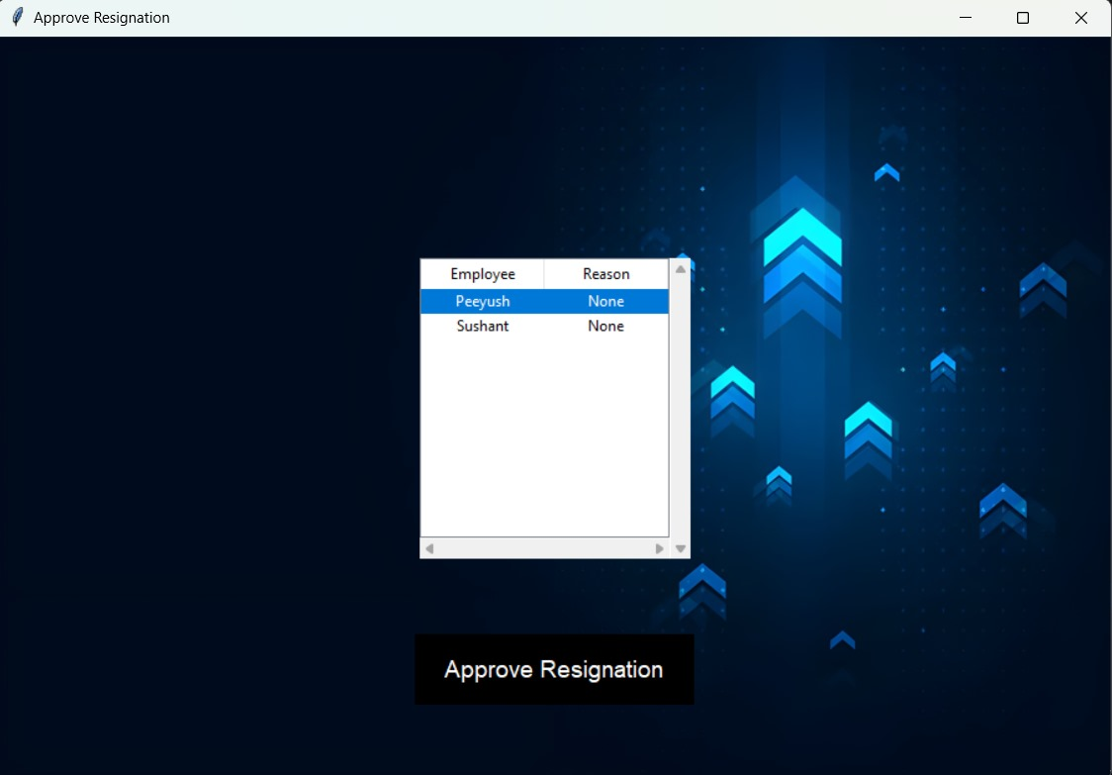
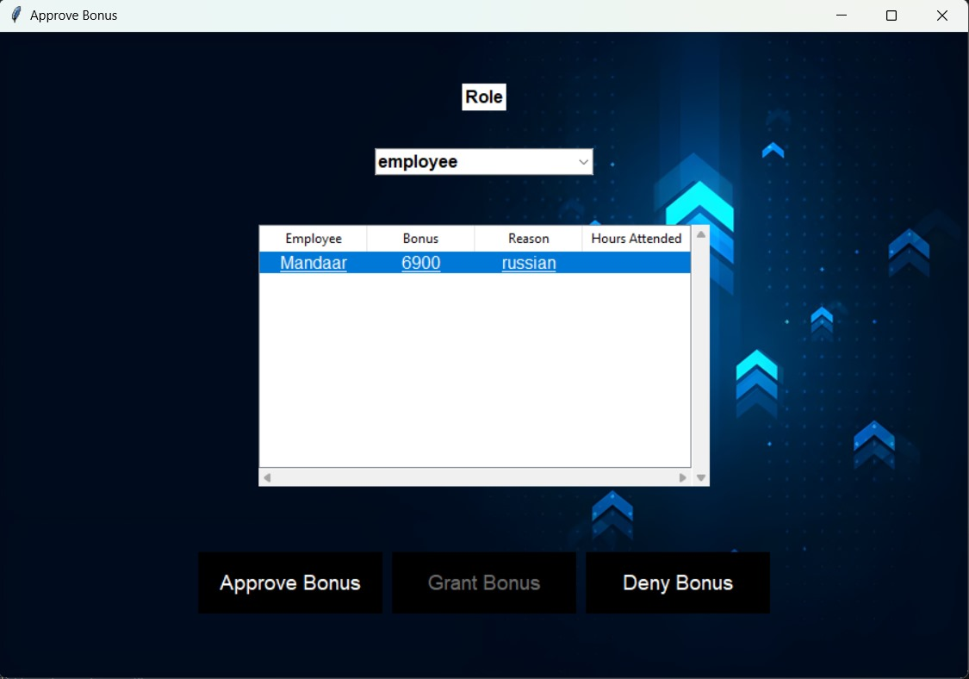
Login HR: -
The figure 11 shows the if the employee aply for the bonus then the approval goes to head if they approve then he gets the pop up when he opens the window
The figure 12 shows the approve resignation. "Approve resignation" means giving permission for someone to leave their job voluntarily.
Figure 11
Figure 11

Slide 24
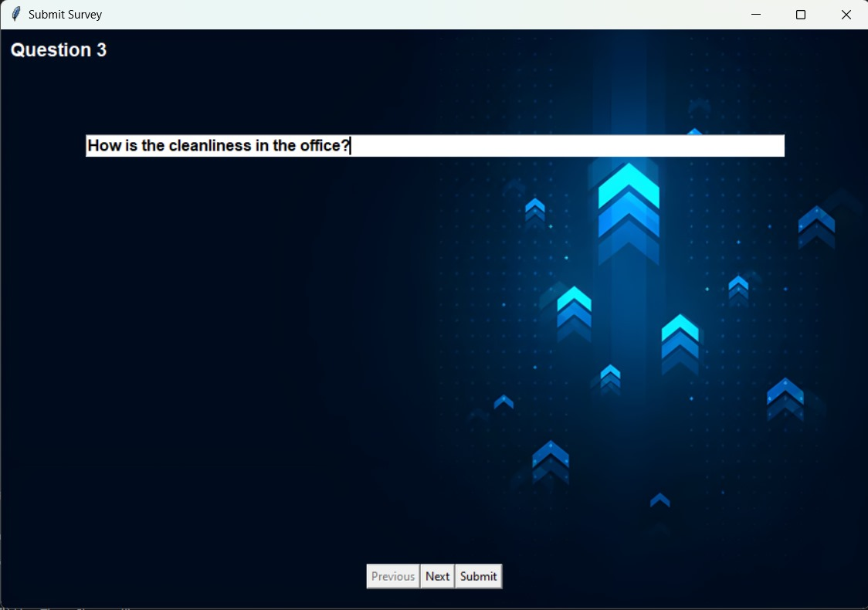
Login HR: -
The figure 13 shows the creating the Create survey for the employee .means making a set of questions for people to answer, usually to gather opinions or information on a specific topic.
Figure 13

Slide 25
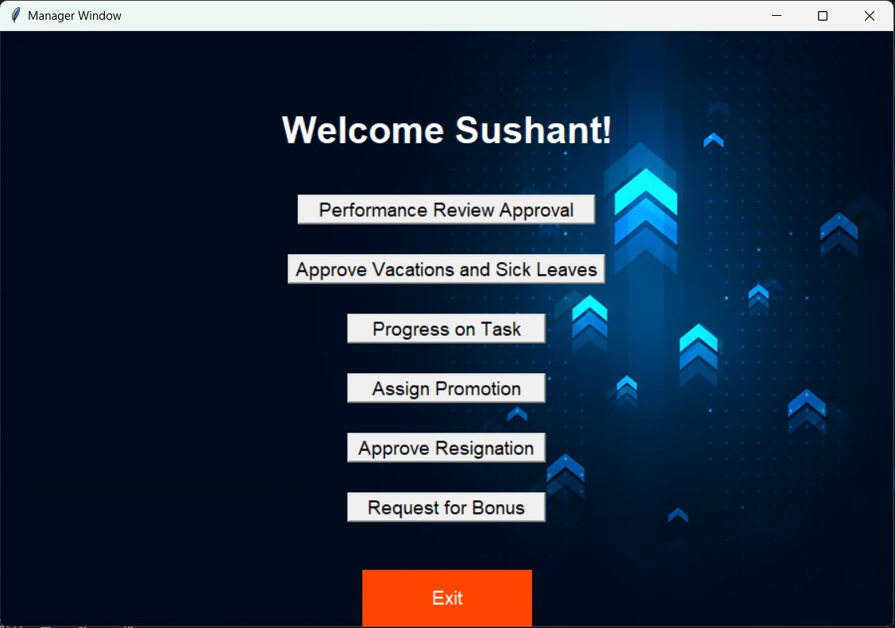
Login Manager: -
The figure 14 shows the login page of the manager .A manager's main job is to lead and organize a team to get work done efficiently and effectively.
Figure 14

Slide 26
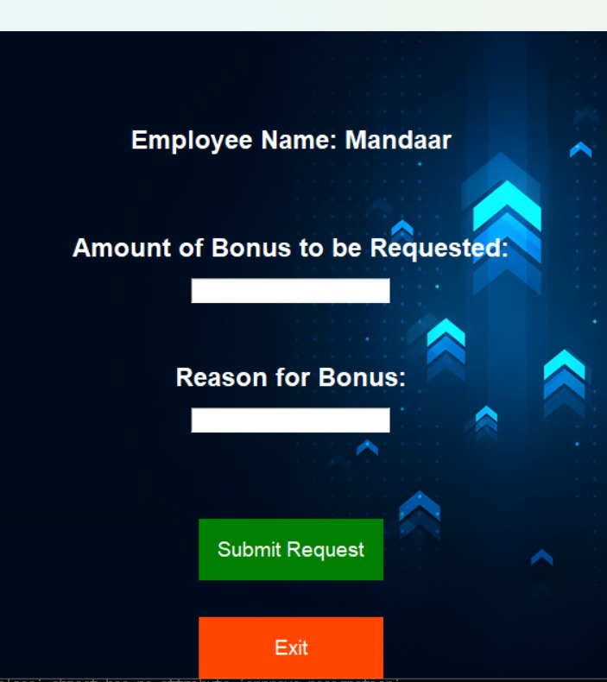
Login Manager: -
The figure 15 shows the request for bonus for specific employee . means asking the company to give extra money to a particular employee as a reward for their hard work or achievements.
Figure 15

Slide 27
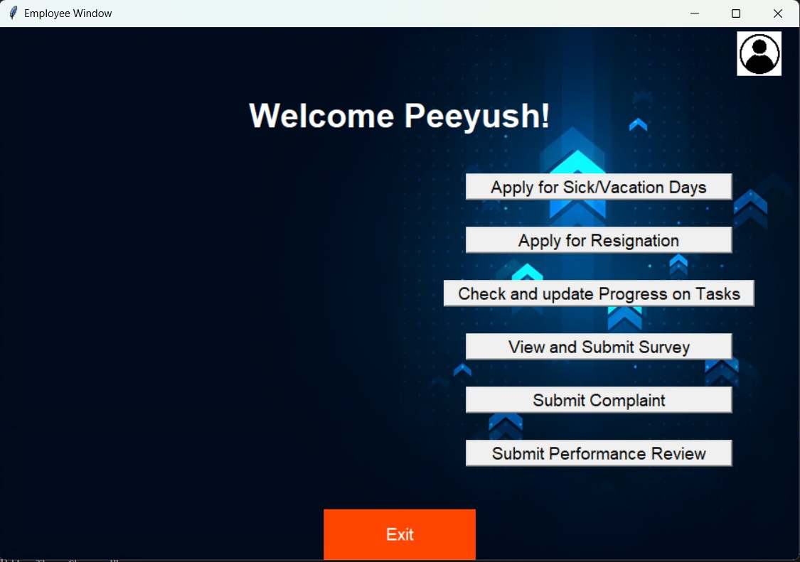
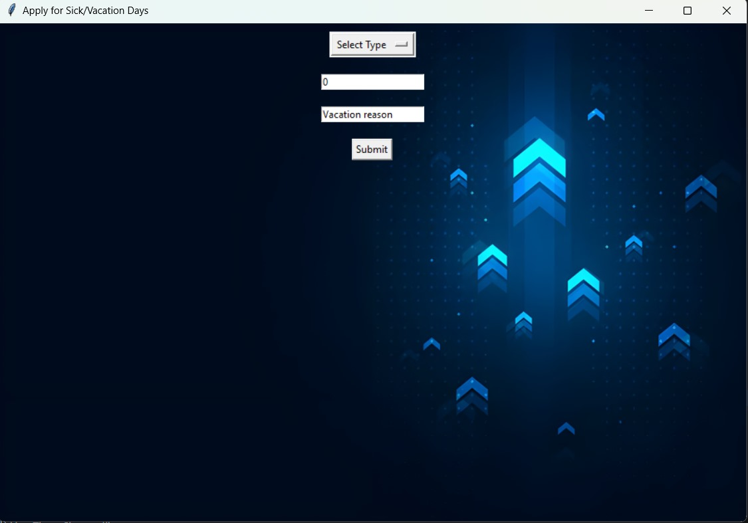
Employee login :-
The figure 16 shows the employee main. An employee's main job is to work for a company, doing tasks and following instructions to help the business succeed.
The figure 17 shows the seek vacation approval. the means asking for time off from work to take a break, relax, or go on a holiday.
Figure 16
Figure 17

Slide 28
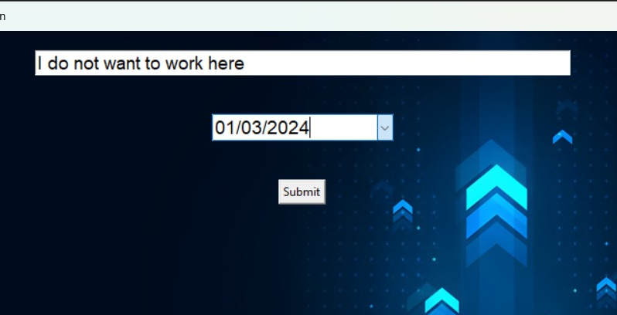
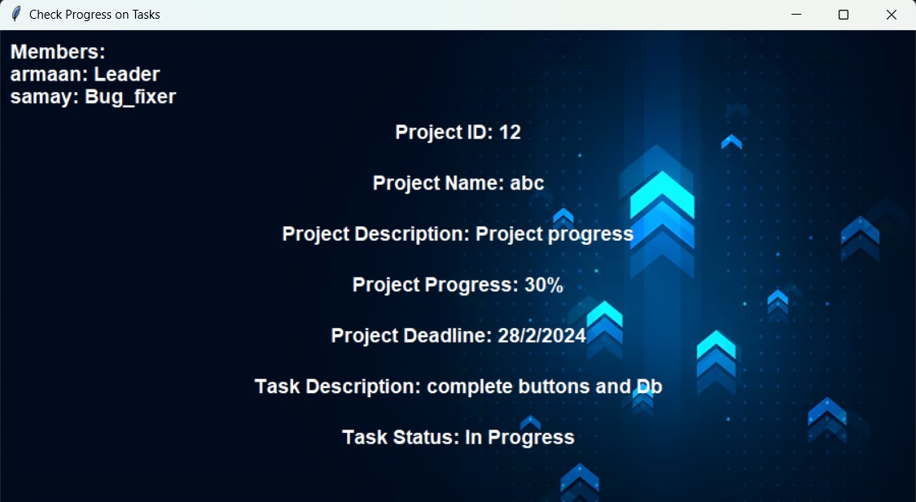
Employee Login:-
The figure 18 shows the apply for resignation. Means formally informing your employer that you want to quit your job and leave the company.
The figure 19 shows the check progress on task. means to review how far along a specific job or assignment has come, ensuring it's on track and making any necessary adjustments if it's not
Figure 18
Figure 19

Slide 29
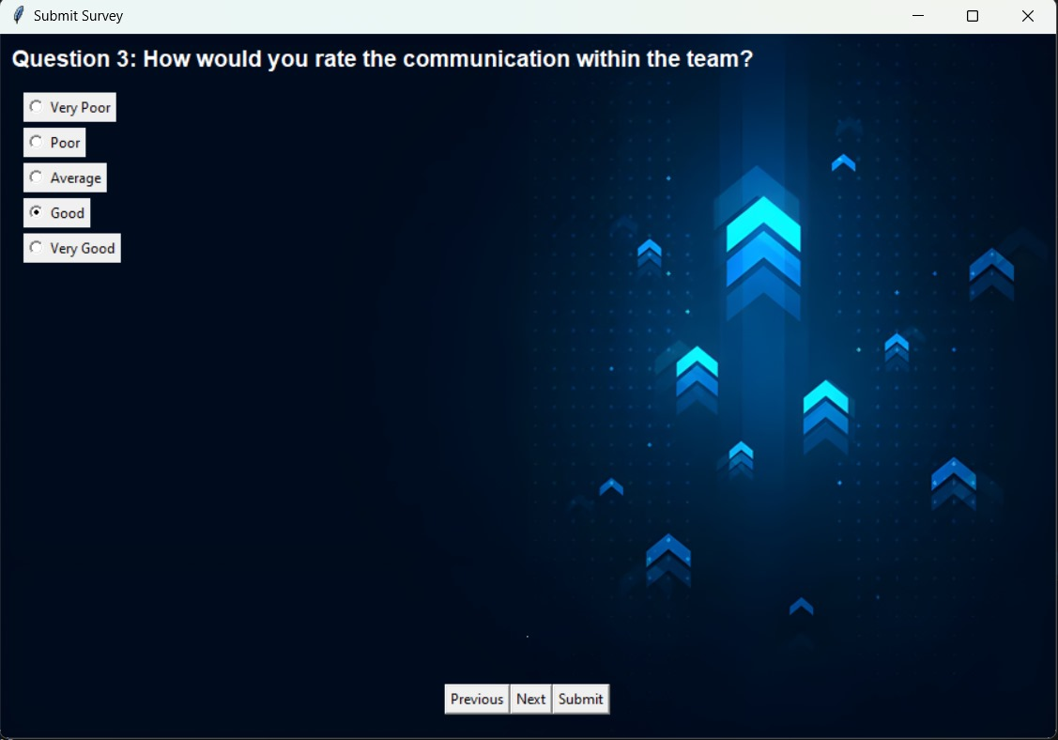
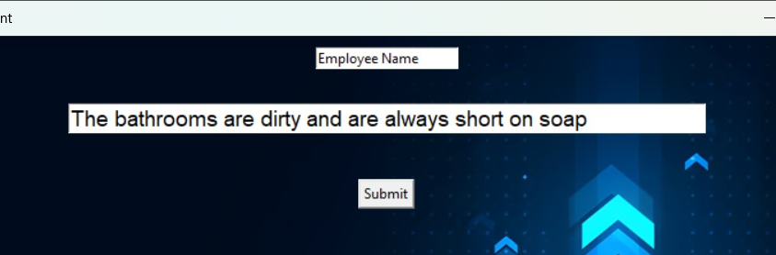
Employee Login:-
The figure 20 shows the submit survey. means sending in the completed set of questions or responses that you were asked to fill out, typically for gathering feedback or information on a particular topic or issue
The figure 21 shows the submit complain. means to formally bring forward a concern or grievance to the appropriate authority or organization, seeking resolution or action regarding an issue or problem.
Figure 20
Figure 21

Slide 30
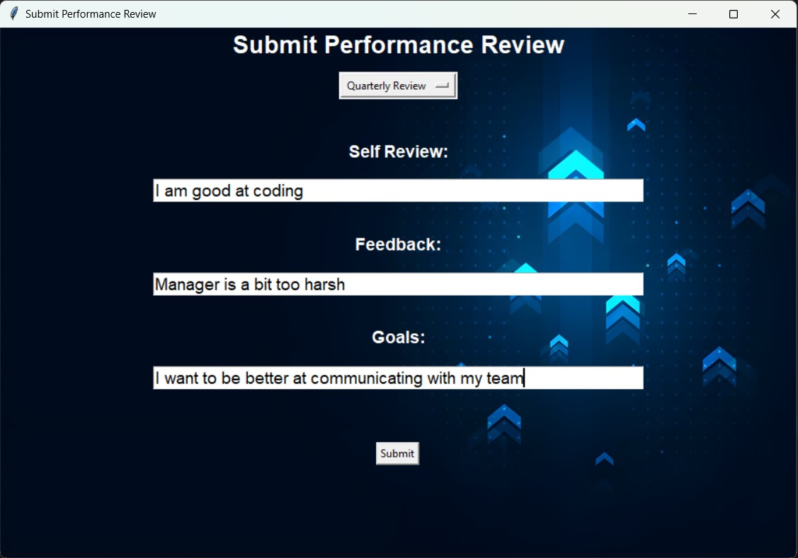
Employee Login:-
The figure 22 shows the submit performance review. refers to providing feedback or evaluation of an individual's job performance to the relevant authority within the organization, typically as part of a formal review process.
Figure 22

Slide 31
References
References:
ChatGPT (OpenAI):
i.Useful for resolving technical issues and bug fixes during the project development process.
ii.Website: OpenAI
2. GeeksforGeeks: A valuable resource for generating ideas, solutions to coding challenges, and technical insights. Website: GeeksforGeeks
3. YouTube: A platform to explore a wide range of video tutorials, demonstrations, and insights related to mobile game development and user interface design.
Website: YouTube
4.Overstack: A community-based space to find and contribute answers to technical challenges, and one of the most popular websites in the world.
5.GitHub: It is a developer platform that allows developers to create, store, manage and share their code. It uses Git software, providing the distributed version control of Git plus access control, bug tracking, software feature requests, task management, continuous integration, and wikis for every project.
The Github Repository of this Project with the Source code, Project Report and a copy of this PPT can be found at: https://github.com/Armaan4477/Backup-MP4

Slide 32
Thank You!!!

